Slide 1
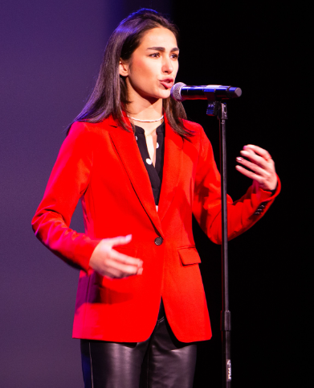
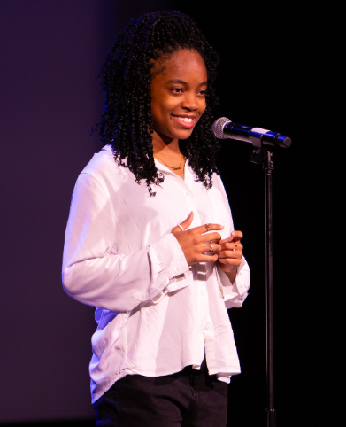
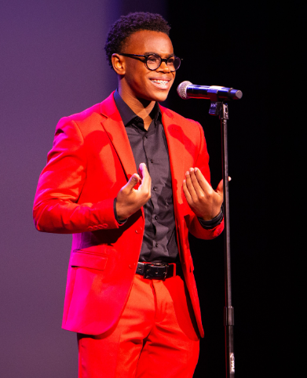
Office Hours
Virtual (via Zoom)
Thursday, November 14 (4-5 PM EST)
Thursday, December 5 (3-4 PM EST)
​
#POL2025 | #IAmPoetryOutLoud | #POL20Years

Slide 2
Our North Star
Poetry Out Loud at the Alliance Theatre --
We wholeheartedly support teachers.
We encourage students to bring their authentic, whole selves and share their unique gifts and truths.
We celebrate the community.

Slide 3
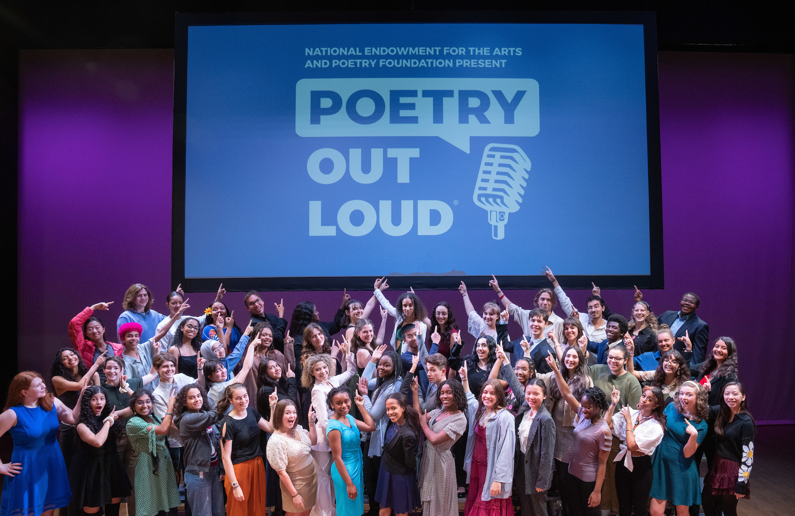
Poetry Out Loud
is a national arts education program that encourages the study of great poetry by offering free educational materials and a dynamic recitation competition for high school students across the country.

Slide 4
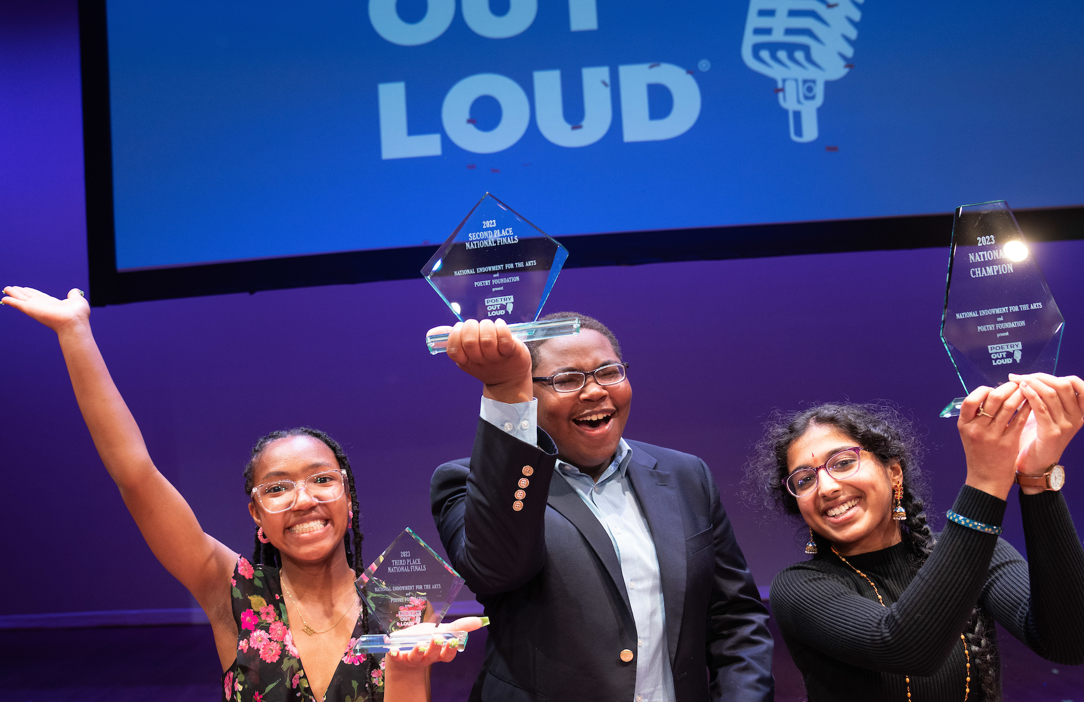
Poetry Out Loud Structure
Local Contests
by Friday,
January 24, 2025
Regional Contests
February 2025
(4 contests)
State
Final
Saturday,
March 8, 2025
National
Finals
Monday, May 5 -
Wednesday, May 7, 2025

Slide 5
Local Contests
🗓 Friday, January 17, 2025 (11:59 PM): Deadline for schools and community organizations to register for the 2024-2025 Poetry Out Loud program in Georgia
Visit: https://www.alliancetheatre.org/poetry-out-loud
Select: [Register]
🗓 Wednesday, January 29, 2025 (11:59 PM): Deadline for schools and community organizations to hold a local contest and report a local champion (who will advance onto Regional Contests).
Recommend: hold your local contest in the fall semester, if possible.
If not possible, a few weeks of wiggle room at top of the new year are built!
Note: due to inclement weather in January, this deadline was extended from its original date: Friday, Jan. 24

Slide 6
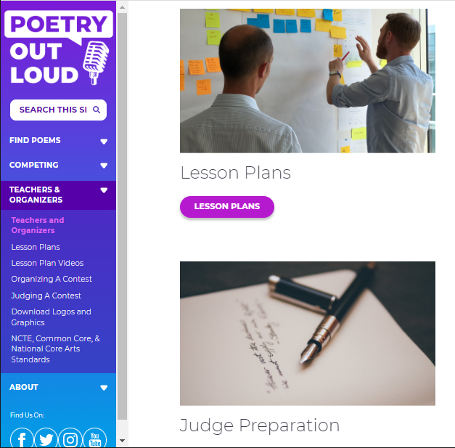
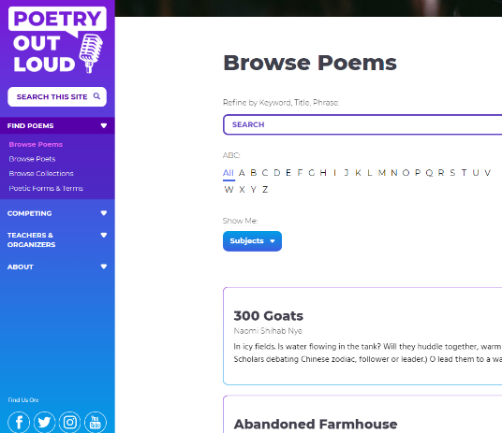
Website Tools for Teachers & Students
PoetryOutLoud.org
Poetry anthology
Teacher’s guide
Audio and video clips
Lesson plans
Judge’s guide
Tips on hosting a contest
Search tools: browse by poet, poem, subject, or thematic collections
Daily “featured poet” section with biographies and poems
Free mobile app for iOS and Android

Slide 7
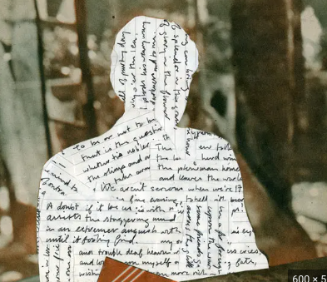
Student Workshops (2-hour)
Preparation for Regional Contests
💻 Virtual: Saturday, January 25 @ 2:30 – 4:30 PM (Live; via Zoom)
Preparation for State Final
💻 Virtual: Saturday, February 22 @ 2:30 – 4:30 PM (Live; via Zoom)
Workshops will address all Evaluation Criteria:
Physical Presence
Voice and Articulation
Interpretation (formerly "Dramatic Appropriateness")
Evidence of Understanding
Overall Performance
Accuracy
Photo Source: New York Times
Opinion: "Memorize that Poem!"

Slide 8
Regional Contests
In-Person Regional Contests:
📍Metro Atlanta (South): Saturday, February 1 @ 2 PM (Trilith Studios; Fayetteville, GA)
📍Metro Atlanta (Central): Saturday, February 8 @ 11 AM (Alliance Theatre; Atlanta, GA)
📍Metro Atlanta (North): Saturday, February 8 @ 3 PM (Alliance Theatre; Atlanta, GA)
Virtual Regional Contest:
💻 Virtual Option: Wednesday, February 12 @ 5 PM (Live; via Zoom)
🚨 Recommend: Utilize in the event of illness or emergency
What to Expect:
🥊 Round 1: All Students | Round 2: Top % (TBD based on final student participation numbers)
🎤 Prepare: 2 poems | Encouraged: (1) Pre-20th Century + (1) 25-lines or fewer

Slide 9
Regional Contest Updates (1/30/25)
Please be advised that, due to registration and contest participation projections, the following changes have been made to the Poetry Out Loud schedule
Effective 12/19/2024:
Canceled: WEST (Columbus, GA): Saturday, February 1, 2025 (4 PM EST) at Columbus State University - Bo Bartlett Center
Added: METRO ATLANTA SOUTH (Fayetteville, GA): Saturday, February 1, 2025 (2 PM EST) at Trilith Studios - Production Center
Effective 1/30/2025:
Canceled: EAST (Savannah, GA): Saturday, February 1 @ 2 PM at Georgia Southern University

Slide 10
State Final
In-Person State Final:
📍State Final: Saturday, March 8 @ 3 PM (Alliance Theatre; Atlanta, GA)
🚫 There is no Virtual Option for the State Final
🏆Approximately 15-20 students will participate in the State Final
What to Expect:
🥊Round 1: All Students | Round 2: Top % (TBD) | Round 3: Top 5
🎤 Prepare: 3 poems | Required: (1) Pre-20th Century + (1) 25-lines or fewer

Slide 11
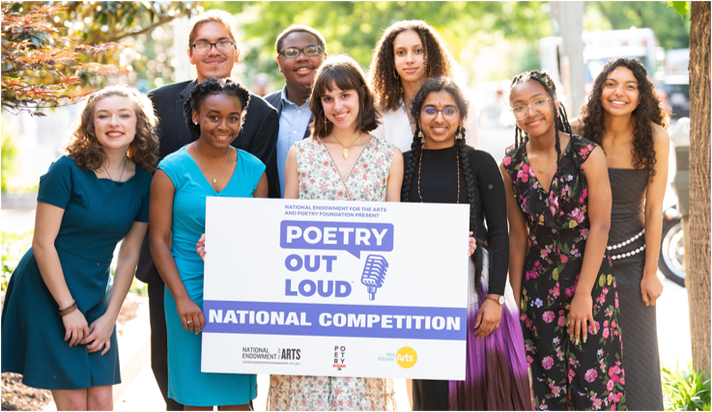
National Finals
🗓 National Finals: Monday, May 5 – Wednesday, May 7, 2025 (Washington, DC)
✈️: Prizes and Travel are provided and administered by the Poetry Foundation

Slide 12
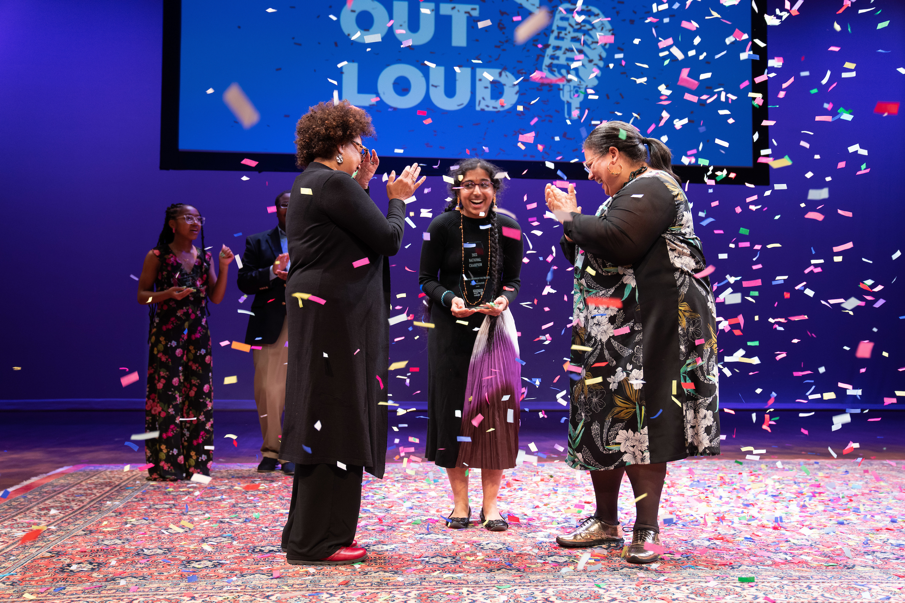
Prizes at State and National Finals
State Finals
$200 for POL State Champion
$500 stipend for school or organization for poetry materials
$100 for POL State Runner-Up
$200 stipend for school or community organization for poetry materials
National Finals
$20,000 for POL National Champion
$10,000 and $5,000 for the second and third place national finalists
$1,000 each for the other six national finalists and for three honorable mention recipients
$500 stipend for schools/organizations of top nine finalists and three honorable mention recipients to purchase poetry materials

Slide 13
Questions + Discussion

Slide 14
Closure
Action Items:
✅ Register for the program by Friday, January 17, 2025
✅ Hold a local contest and report a champion by Wednesday, January 29, 2025
Contact:
Liz Davis, Producer – liz.davis@alliancetheatre.org
Katie Wolff, Associate Producer – katie.wolff@alliancetheatre.org
General Inquiries: poetryoutloud@alliancetheatre.org

Slide 15
Credits & Acknowledgments
Poetry Out Loud is a partnership of the National Endowment for the Arts, the Poetry Foundation, and the State and Jurisdictional Arts Agencies of the United States.
All photos and screenshots [on Poetry Out Loud slides] taken by James Kegley & 5:00 Films.

